Slide 1

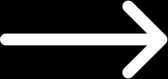
Thomas and Friends
TRAIN MANAGEMENT
SYSTEM
BUSINESS PRESENTATION

Slide 2


TEAM MEMBERS
PRESENTATION
01
04
TAN EASON
LIM WAI KIT
02
05
SHANNELL WONG SI YUAN
CHAI JING YI
03
NG JING YONG
THOMAS AND FRIENDS

Slide 3


ABOUT US
GREETING FROM US
We are a dedicated team of software developers specializing in building comprehensive Train Management Systems. With a deep understanding of the unique challenges faced by the rail industry, we create innovative solutions that streamline operations, enhance safety, and improve overall efficiency.
We are committed to delivering reliable, scalable, and user-friendly systems that meet the evolving needs of modern railway networks.
Driven by a passion for technology and a focus on problem-solving, our team works closely with clients to customize solutions that optimize rail operations.

Slide 4

PROBLEMS
WE WILL SOLVE THE PROBLEMS
01
System Complexity and Performance Bottlenecks
(Facilities and Service)
  Tight coupling between the application and the database
  Excessive maintenance costs
  Performance bottlenecks
  Scalability of the system is limited
02
Non effective promotions due to poor user interface (Marketing)
  Inefficient Adjustment and Updates
  Challenges in Monitoring Performance
  Difficulty in Creating Promotions

Slide 5
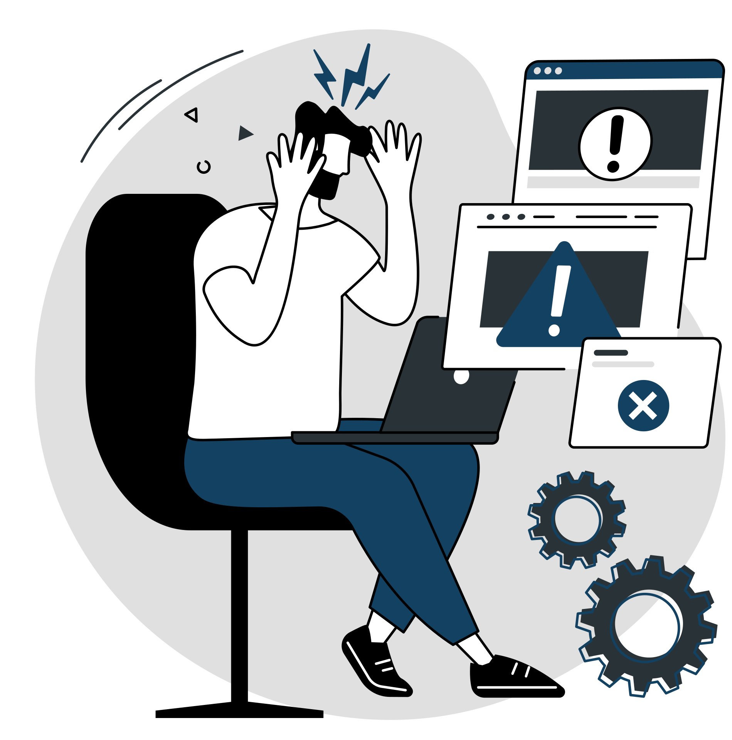
PROBLEMS
WE WILL SOLVE THE PROBLEMS
03
Delay in responding to customers issues (Customer Service)
  Increase in complaints
  Inefficient Use of Resources
04
Maintenance time take too long and not effective (IT)
  Downtime and Disruptions
  Increased Operational Costs
  Delayed Upgrades and Enhancements
05
Shift coverage issues (HR)
  Operation Disruption
  Staff attitude
  Distraction of task

Slide 6
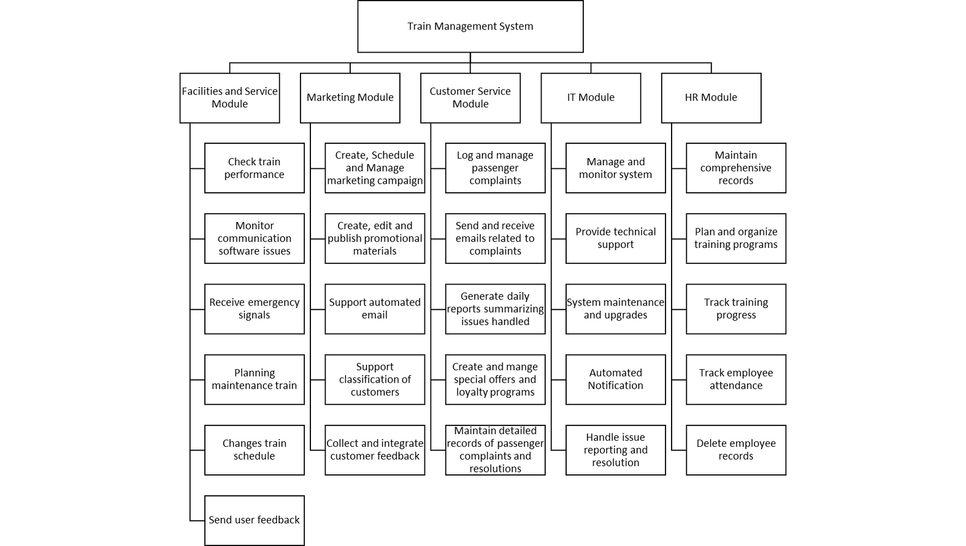
PRODUCT OVERVIEW
TRAIN MANAGEMENT SYSTEM (TMS) OVERVIEW
What is TMS?
  A unified platform designed to enhance train operations by integrating key functions: Train Scheduling, Marketing, Customer Service, Marketing, IT monitoring​, HR Management

Slide 7


SOLUTIONS
01
Refactor the System Architecture
(Facilities and Service)
SOLUTIONS OF THE PROBLEMS
  Flexibility
  Adaptability
  Centralized logic
02
User Interface Redesign
(Marketing)
  Improved Usability
  Better Performance Monitoring
  Higher User Satisfaction
03
Digitize Existing Records
(Customer Service)
  Quickly search and retrieve historial inquiries and solution
  Reduce time spent
Thomas and Friends

Slide 8


SOLUTION
Thomas and Friends
SOLUTIONS OF THE PROBLEMS
04
Centralized Issue Reporting
(IT)
05
Implement Real-Time Attendance Tracking
(HR)
  Real-time tracking
  Automated notification
  Saving time and reducing workload
  Enabling swift replacement and maintaining shift coverage
  Quick adjustments to staff assignments
  Quick identification and notification of attendance issues

Slide 9

FUNCTIONAL REQUIREMENT
Marketing Department
  Create, schedule and manage marketing campaigns
  Create,edit and publish promotional material
  Support automated email
  Support classification of customers
  Collect and integrate customer feedback
Facilities and Service Department
  Check the train’s performance
  Monitor communication software issues
  Receive emergency signals
  Planning maintenance train
  Change train schedule
Customer Service Department
  Log and manage passenger complaints
  Send and receive emails related to complaints
  Generate daliy reports summarizing issues handled
  Create and manage special offers and loyalty programs
  Maintain detailed records of passenger complaints and resolution

Slide 10
FUNCTIONAL REQUIREMENT
Thomas and Friends
IT Department
HR Department
  Manage and monitor systems
  Provide technical support
  System maintenance and upgrades
  Automated notification
  Handle issue reporting and resolution
  Maintain comprehensive records
  Plan and organize training programs
  Track training progress
  Track employee attendance
  Delete employee records

Slide 11
EFFICIENCY AND PERFORMANCE IMPROVEMENTS
01
Automation
02
Performance

Slide 12
COST SAVINGS & SAFETY ENHANCEMENTS
01
Cost Savings
02
Safety Enhancements

Slide 13

  FACILITIES AND SERVICE MODULE
Product Walkthrough
  MARKETING MODULE
  CUSTOMER SERVICE MODULE
USER INTERFACE OVERVIEW
  IT MODULE
  HR MODULE

Slide 14

QUALITY ATTRIBUTES
OVERALL SYSTEM
01
Functionality
03
  Feature Completeness
  Accuracy
  Security
Reliability
05
Supportability
  Availability
  Fault Tolerance
  Data Intefrity
  Maintainability
  Documentation and Training
  Monitoring and Diagnostics
02
Usability
  Ease of Use
  User Interface Design
  Accessibility
04
Performance
  Response Time
  Scalability
  Resource Efficiency
Thomas and Friends

Slide 15
ROI AND FUTURE-PROOFING
01
Cost Efficiency
02
Scalability & Future-Proofing
Real Examples
  Reduced delays and improved customer satisfaction will lead to better operational efficiency and higher passenger loyalty.

Slide 16
Thomas and Friends
THANK YOU
FOR YOUR NICE ATTENTION

